Slide 1

`
Naukri Job Market Analysis
Presented by - K Tejaswi
Batch No. 493

Slide 2


Problem Statement
Objective
Data Collection Process
Data Preprocessing
Exploratory Data Analysis
Statistical Analysis
Key Business Insights
Conclusion
Future Enhancements
Agenda

Slide 3
Business Problem
Understanding current job market trends manually is difficult due to the large volume of job postings available on recruitment platforms.
This project uses web scraping and data analysis to:
Collect job market data,
Identify hiring trends,
Analyze salary patterns,
Also uncover insights related to skills, experience, and locations.

Slide 4

Project Objective
Extract job listings using Selenium
Perform data cleaning & preprocessing
Analyze salary distribution
Study experience requirements
Identify top hiring locations
Discover in-demand skills
Perform statistical analysis

Slide 5
Tools Used
TOOL | PURPOSE
Python | Programming
Selenium | Web Scraping
Pandas | Data Cleaning
NumPy | Numerical Operations
Matplotlib | Visualization
Seaborn | Statistical Charts
Jupyter Notebook | Development

Slide 6
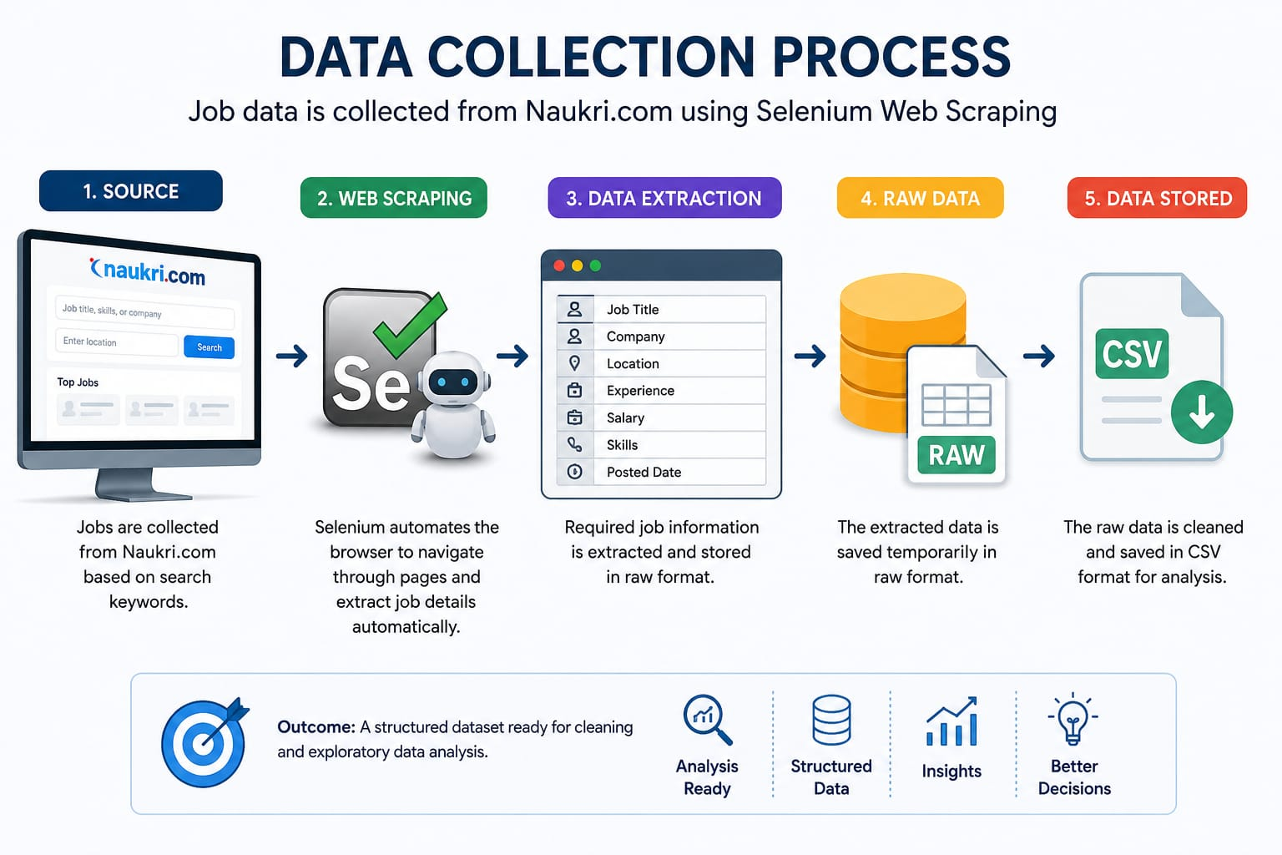
Data Collection Process
Source
Naukri Job Portal
Data Extracted
Job Title
Company Name
Salary
Experience
Location
Industry
Posted Days

Slide 7
Data Cleaning and Preprocessing Process
Steps Performed
Handled missing values
Cleaned salary formats and created new columns using the salary column
Standardized experience ranges and created new columns using it
Converted data types
Handled outliers, most of them are False outliers
Kept the duplicates, because repeated job postings were observed due to reposting and sponsored listings on the job portal. Exact duplicates were retained to preserve real-world job demand frequency.

Slide 8
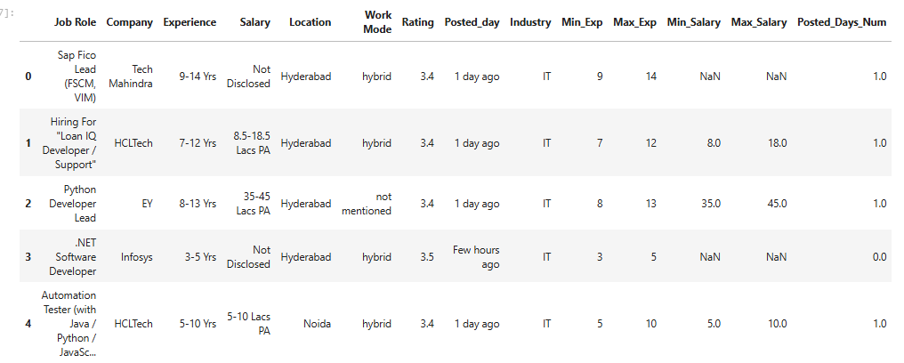
Dataset Overview
Metric | Value
Total Records | 2240
Total Features | 14
Numerical Columns | 5
Categorical Columns | 9

Slide 9
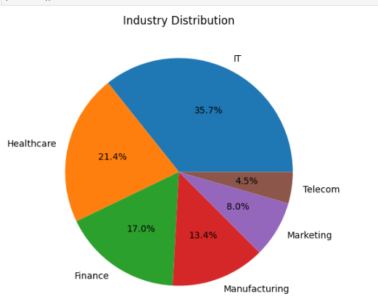
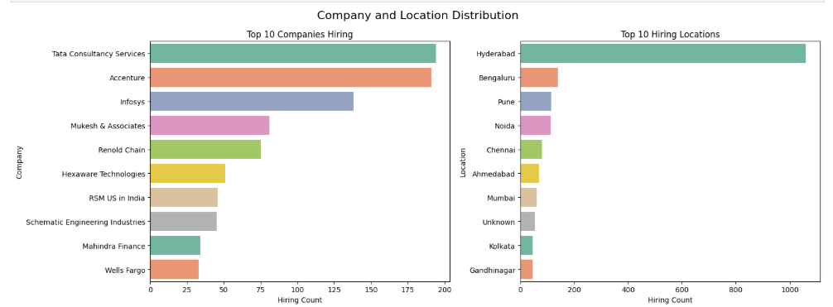
Univariate Analysis
Categorical Columns
IT industry dominates the job market, while Healthcare and Finance also show strong hiring demand.
TCS, Accenture, and Infosys are the leading companies with the highest recruitment activity.
Hyderabad, Bengaluru, and Pune emerge as the top hiring locations, highlighting major tech hubs.

Slide 10
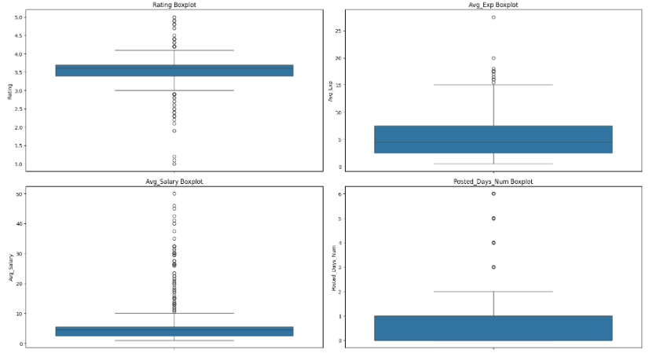
Numerical Columns
The salary-related features show many outliers, indicating the presence of a few high-paying jobs compared to the majority of listings.
Most job postings require low to mid-level experience, while very high experience requirements are rare.
Ratings are concentrated within a narrow range, showing limited variation across companies.
Posted days are mostly recent, suggesting that the dataset primarily contains newly active job postings.

Slide 11
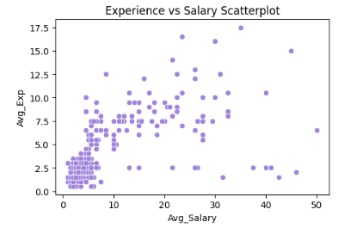
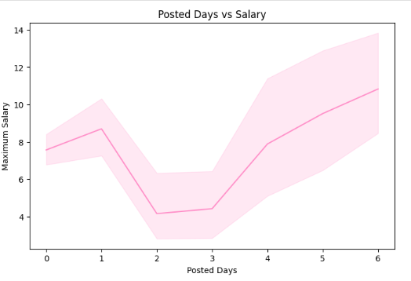
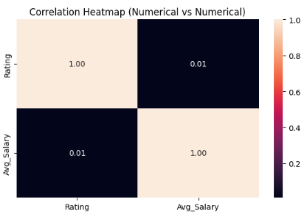
Univariate Analysis
Numerical vs Numerical Columns
The scatterplot shows a positive relationship between experience and salary, where higher experience generally leads to better salary packages.
The Posted Days vs Salary graph indicates that recently posted jobs tend to offer comparatively higher salaries.
The correlation heatmap shows a very weak correlation (0.03) between company rating and salary.
Overall, experience appears to influence salary more strongly than ratings or posting duration.

Slide 12
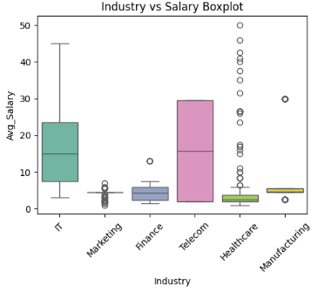
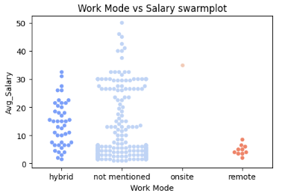
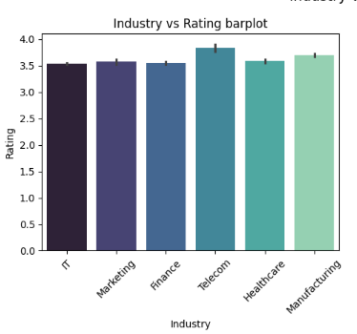
Numerical vs Categorical Columns
The salary distribution varies significantly across industries, with IT and Telecom showing higher salary ranges and more outliers.
Telecom industry has the highest average company ratings, while other industries maintain relatively similar ratings.
The swarmplot shows that hybrid and unspecified work modes contain the majority of high-paying job opportunities.
Overall, industry type and work mode appear to influence salary levels more strongly than company ratings.

Slide 13
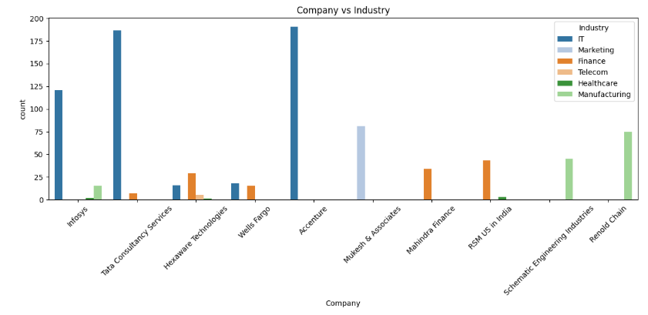
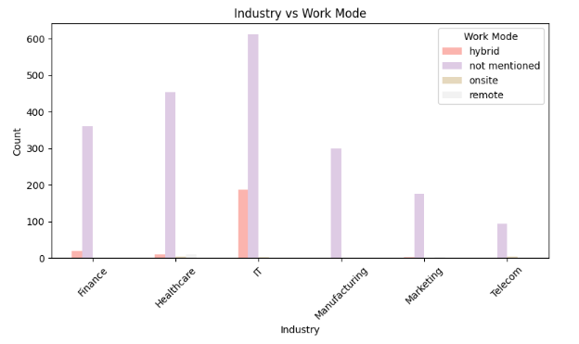
Categorical vs Categorical columns
The Company vs Industry graph shows that large companies mainly dominate specific industries, especially IT and Manufacturing sectors.
Companies like Accenture, TCS, and Infosys contribute heavily to IT-related job opportunities.
The Industry vs Work Mode graph indicates that most industries do not clearly specify work mode in job postings.
Hybrid roles are most commonly observed in the IT sector, highlighting greater workplace flexibility in tech industries.
.

Slide 14
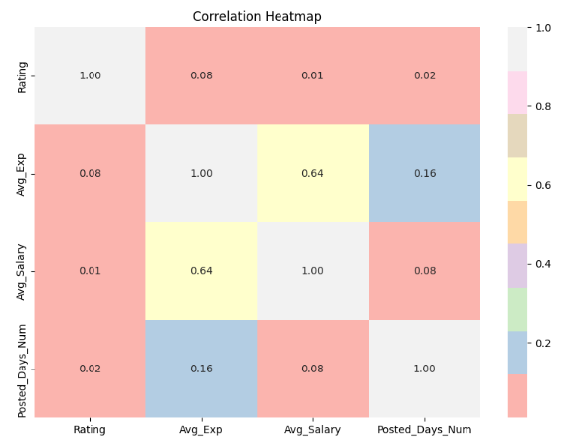
Multivariate Analysis
Minimum and maximum experience show a very strong positive correlation (0.94), indicating consistent experience requirements across job roles.
Salary has a strong positive relationship with experience, especially with maximum experience (0.70).
Minimum salary and maximum salary are moderately correlated, meaning higher base salaries usually lead to higher salary ranges.
Company ratings have very weak correlation with salary, suggesting ratings do not strongly influence pay.
Posted days show minimal correlation with other variables, indicating posting duration has little impact on salary trends.
Overall, experience-related features are the strongest factors influencing salary in the dataset.

Slide 15
Hypothesis Testing / Statistical Analysis
Objective
To statistically verify whether factors like experience, industry, ratings, and work mode significantly influence salary trends in the job market dataset.
Hypothesis 1: Experience vs Salary
P-value < 0.05
Reject H0
Experience significantly affects salary, and higher experience generally results in better salary packages.
Hypothesis 2: Industry vs Salary
P-value < 0.05
Different industries offer significantly different salary ranges, with IT and Telecom showing higher salaries.
Hypothesis 3: Work Mode vs Salary
P-value < 0.05
Work mode significantly affects salary distribution, with hybrid and onsite roles generally offering higher salary packages compared to remote roles.

Slide 16
Key Insights
IT industry dominates the job market with the highest number of job openings among all sectors.
Hyderabad, Bengaluru, and Pune emerged as the leading hiring locations, highlighting major tech hubs.
Experience has a strong positive relationship with salary, indicating that higher experience leads to better pay packages.
Most job postings fall under hybrid or unspecified work modes, while fully remote roles remain limited.
Large IT service companies such as TCS, Accenture, and Infosys contribute significantly to recruitment demand.
Industry type and experience were identified as the strongest factors influencing salary trends.
Company ratings showed very weak correlation with salary, suggesting ratings do not strongly affect compensation.
Recently posted jobs tend to attract higher engagement and often offer competitive salary ranges.

Slide 17
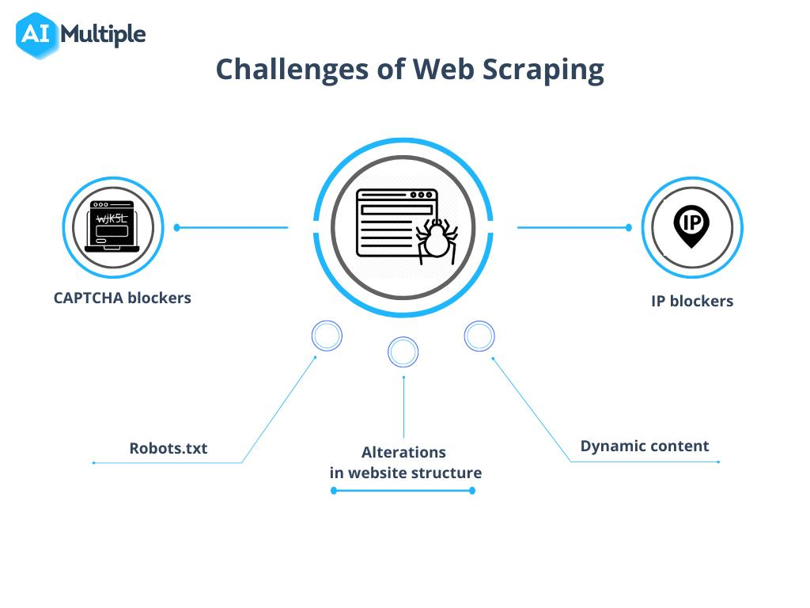
Dynamic webpage loading
Handling missing salary values
Inconsistent text formatting
Selenium delays/timeouts
Data preprocessing complexity
Challenges Faced

Slide 18
Conclusion
This project successfully extracted and analyzed job market data using web scraping and EDA techniques.
The analysis helped uncover:
Hiring trends
Salary patterns
Experience requirements
In-demand skills
The project demonstrates how data analytics can support better career and hiring decisions.

Slide 19

Future Enhancements
Build interactive dashboard
Use machine learning for salary prediction
Automate daily job tracking
Deploy as web application
Perform real-time analytics

Slide 20


Slide 21


